Slide 1
Dialogue Systems and Chatbots
Jurafsky and Martin Chapter 26

Slide 2
Conversational Agents aka Dialogue Systems
Digital Assistants
(Siri, Alexa, Cortana, Google Home)
Answering questions on corporate websites
Communicating with robots
Chatting for fun
Clinical uses

Slide 3
Two Classes of Dialog Systems
Task-Oriented Dialogue Agents
Goal-Based Agents
Siri, interface with robots, booking flights or hotels
Chatbots
Systems designed for extended conversations
Chatting for fun and entertainment
ELIZA (1966), PARRY (1968)

Slide 4
Challenging properties of human conversation
Taking turns during conversation
Speech acts
Grounding
Dialogue structure
Initiative
Implicature

Slide 5
Part I: Chatbots
Systems designed for extended conversations
Mimic the unstructured conversations or ‘chats’ characteristic of informal human-human interaction
ELIZA (1966), PARRY (1968), ALICE, CLEVER, Microsoft Little Bing

Slide 6
Chatbot Architectures
Rule-Based
Pattern-action rules (Eliza)
+ a mental model (Parry)
Corpus-Based
Information Retrieval
Neural network encoder-decoder
Notes:
Corpus-based systems mine large datasets of human-human conversations, which can be done by using information retrieval (IR-based systems simply copy a human’s response from a previous conversation) or by using a machine translation paradigm such as neural network sequence-to-sequence systems, to learn to map from a user utterance to a system response.

Slide 7
ELIZA: Weizenbaum (1966)

Slide 8
ELIZA: Weizenbaum (1966)

Slide 9
How does Eliza work?
Simulate a Rogerian psychologist
Draw the patient out by reflecting patient’s statements back at them
Rogerian psychology – Rare type of conversation “assume the pose of knowing almost nothing of the real world”

Slide 10
ELIZA Pattern/Transform Rules
(0 YOU 0 ME) [pattern]
(WHAT MAKES YOU THINK I 3 YOU) [transform]
0 means Kleene *
Number 3 refers to the second 0 in the first pattern.
This rule would transfer
You hate me
into
WHAT MAKES YOU THINK I HATE YOU

Slide 11
Simplified sketch of ELIZA

Slide 12
PARRY: Colby (1971)
ELIZA like regular expressions
But a much richer –
Control Structure
Language Understanding Capabilities
Mental Model : Parry has affective variables
Fear, Mistrust, Anger
If Anger level is high, respond with hostility
First system to pass the Turing test (1971)

Slide 13
Eliza Meets Parry
Good Evening. Tell me your problems. Please terminate input with a period or a question mark.
*People get on my nerves sometimes.
I am not sure I understand you fully.
*You should pay more attention.
Suppose you should pay more attention.
*You're entitled to your own opinion.
What makes you think I am entitled to my own opinion?
*It bothers me just to be around people in general.
Please go on.
*I went to the track at Bay Meadows a while back.
What does that suggest to you?
*I went to the races.
What else would you like to discuss?

Slide 14
*Horseracing interests me.
Why do you say that just now?
*There's a lot of crooked gambling going on there.
I am not sure I understand you fully,
*It's clear to me if not to you.
Do you think its likely that not to I?
*I went to the races.
Please go on.
*I gamble on horses.
What does that suggest to you?
*I went to the races.
What else would you like to discuss?
*Gambling has been nothing but trouble to me.
Why do you say that just now?
*I've had experience with crooks gambling at the track.
I am not sure I understand you fully.
*I've already told you enough about that.

Slide 15
Corpus-based chatbots
Mine conversations of human chats or mine the human sides of human-machine chats
Data-intensive: Large conversational corpora
Microblogs: Twitter or Weibo
Movie Dialogs
Telephone, Conversations
CleverBot, Microsoft XiaoIce

Slide 16
Two Main Architectures
Information Retrieval
Machine Learned Sequence Transduction
- Focus on generating a single response turn that is appropriate given the user’s immediately previous utterance or two

Slide 17
Two IR-based Chatbot Architectures
Return the response to the most similar turn
Given user query (q), find a similar turn t in corpus C
Return the human response to t in C
Return the most similar turn

Slide 18
IR-based Models
Can use more features than just words in query q
User features - Information about the user or sentiment
Prior turns – Use conversation so far
Narrative (non-dialogue) text
COBOT chatbot (Isbell et al., 2000) :
Generate responses by selecting sentences from the Unabomber Manifesto by Theodore Kaczynski, articles on alien abduction, the scripts of “The Big Lebowski” and “Planet of the Apes”
Wikipedia Text

Slide 19
Neural Chatbots
Think of response generation as a task of transducing from the user’s prior turn to the system’s turn
Response generation using encoder-decoder models
Train a deep neural network
Map from user1 turn to user2 response

Slide 20
Seq2seq Architecture

Slide 21
Sample Responses: SEQ2SEQ Model
Responses that are harder to distinguish from human responses

Slide 22
Chatbots: Pros and cons
Pros:
Fun
Applications to counseling
Good for narrow, scriptable applications
Cons:
They don't really understand
Rule-based chatbots are expensive and brittle
IR-based chatbots can only mirror training data
The case of Microsoft Tay
(or, Garbage-in, Garbage-out)
The future: combining chatbots with frame-based agents

Slide 23
Part II: Frame-based Dialogue Systems
Task-based Dialogue Agents
Based on “Domain Ontology”
A set of “Frames”
Frame:
A knowledge structure representing user intentions
A collection of “slots”
Each ”slot” having a set of “values”

Slide 24
Example: Travel Domain
Slot : Origin City
Type : City
Value : San Francisco
Slot Type Question
ORIGIN city What city are you leaving from?
DEST city Where are you going?
DEP DATE date What day would you like to leave?
DEP TIME time What time would you like to leave?
AIRLINE line What is your preferred airline?

Slide 25
Frame-based Dialogue Agents
Artificial Intelligence Journal, 1977
Still the industrial state of the art
SIRI based on GUS architecture

Slide 26
GUS system : An actual dialogue

Slide 27
Slot types can be complex
The type DATE

Slide 28
Control structure for frame-based dialog
Consider a trivial airline travel system:
Ask the user for a departure city
Ask for a destination city
Ask for a time
Ask whether the trip is round-trip or not

Slide 29
Natural language understanding for filling slots in GUS
Domain classification
Asking weather? Booking a flight? Programming alarm clock?
Intent Determination
Find a Movie, Show Flight, Remove Calendar Appt
Slot Filling
Extract the actual slots and fillers

Slide 30
Natural language understanding for filling slots in GUS
Show me morning flights from Boston to SF on Tuesday.

Slide 31
Natural language understanding for filling slots in GUS
Wake me tomorrow at six.

Slide 32
Rule-based Slot-filling
Semantic Grammar Rules or Regular Expressions
Wake me (up) | set (the|an) alarm | get me up
A semantic grammar parse for a user sentence, using slot names as the internal parse tree nodes
Notes:
Semantic grammars can be parsed by any CFG parsing algorithm (see Chapter 13), resulting in a hierarchical labeling of the input string with semantic node labels.

Slide 33
Rule Sets
Collections of rules consisting of:
condition
action
When user input is processed, facts added to store and
rule conditions are evaluated
relevant actions executed

Slide 34
Dialogue-State Architecture
More sophisticated version of frame-based architecture
Williams et al. (2016)

Slide 35
NLU Component:
Extract slot fillers using Machine Learning rather than rules
Dialogue State Tracker:
Maintains current state of dialogue, user’s most recent dialogue act
Dialogue policy:
Decides what the system should do or say next
When to answer user’s questions, when to make a suggestion
Natural Language Generation Component:
Condition on exact context to produce turns that seem much more natural

Slide 36
Dialogue Acts
Combining idea of speech acts and grounding into a single representation
Dialogue acts used by a restaurant recommendation system (Young et al. (2010))

Slide 37
Dialogue Acts
Sample dialogue from the Recommender System of Young et al. (2010)

Slide 38
Machine Learning for Slot Filling
Supervised semantic parsing
Model to map from input words to slot fillers, domain and intent
Given a set of labeled sentences
“I want to fly to San Francisco on Tuesday”
Destination: SF
Depart-date: Tuesday
Requirements: Lots of labeled data

Slide 39
Slot Filling
“I want to fly to San Francisco on Monday afternoon please”
Use 1-of-N classifier (Naive Bayes, Logistic Regression, Neural Network, etc.)
Input:
features like word N-grams
Output:
Domain: AIRLINE
Intent: SHOWFLIGHT

Slide 40
More sophisticated algorithm for Slot Filling: IOB Tagging
IOB Tagging
Tag for the beginning (B) and inside (I) of each slot label,
plus one for tokens outside (O) any slot label
2n + 1 tags, where n is the number of slots
B-DESTINASTION
I-DESTINATION
B-DEPART_TIME
I-DEPART_TIME
O
Training Data: Sentences paired with sequences of IOB labels

Slide 41
Slot Filling
Simple Architecture for slot filling, mapping the words in the input through contextual embeddings to an output classifier layer
Notes:
The input is a series of words w1...wn, which is passed through a contextual embedding model to get contextual word representations. This is followed by a feedforward layer and a softmax at each token position over possible IOB tags, with the output is a series of IOB tags s1...sn. We can also combine the domain-classification and intent-extraction tasks with slot-filling simply by adding a domain concatenated with an intent as the desired output for the final EOS token.

Slide 42
Dialogue State Tracker
Keep track of
Current state of the frame (the fillers of each slot)
User’s most recent dialogue act
Sample output of a dialogue state tracker after each turn

Slide 43

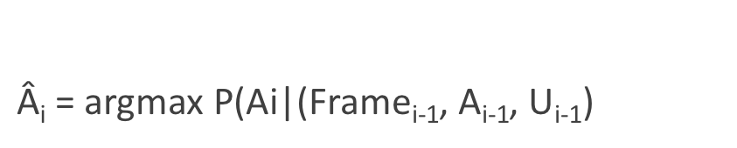
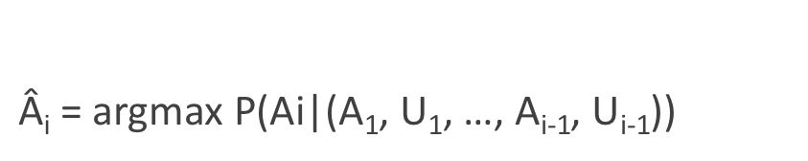
Dialogue Policy
What action the system should take next
What dialogue act to generate
Predict which action A_{i} to take
$\text{Â}\text{i}\text{ = }\text{argmax} \text{P}\text{(}\text{Ai}\text{|}$(A₁, U₁, …, A_{i-1}, U_{i-1}))
$$\text{A}\text{i} ϵ A$$
A = Dialogue Acts from System; U = Dialogue Acts from User
Simplification: Condition just on the current dialogue state
$\text{Â}\text{i}\text{ = }\text{argmax} \text{P}\text{(}\text{Ai}\text{|}$(Frame_{i-1}, A_{i-1}, U_{i-1})
$$\text{A}\text{i} ϵ A$$
Notes:
These probabilities can be estimated by a neural classifier using neural representations of the slot fillers (for example as spans) and the utterances (for example as sentence embeddings computed over contextual embeddings)

Slide 44
Policy Example: Confirmation and Rejection
Explicit Confirmation
Implicit Confirmation

Slide 45
Natural Language Generation
Modeled in two stages:
Content Planning (what to say)
Sentence Realization (how to say it)
Encoder Decoder Models : Map frames to sentences
An encoder decoder sentence realizer mapping slots/fillers to English

Slide 46
Evaluation
Slot Error Rate for a Sentence
# of inserted/deleted/substituted slots
# of total reference slots for sentence
End-to-end evaluation (Task Success)

Slide 47
Evaluation
“Make an appointment with Chris at 10:30 in Gates 104”
Slot | Filler
PERSON | Chris
TIME | 11:30 a.m.
ROOM | Gates 104
Slot error rate: 1/3
Task success: At end, was the correct meeting added to the calendar?

Slide 48
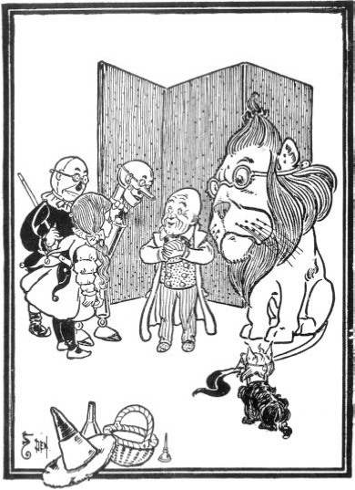
Dialog System Design: User-Centered Design
Gould and Lewis 1985
Study the user and task
Build simulations and prototypes
"Wizard of Oz study"
Iteratively test the design on users

Slide 49
Ethical Issues in Dialog System Design
Machine learning systems replicate biases that occurred in the training data
Dialog datasets
Henderson et al. (2017) examined standard datasets (Twitter, Reddit, movie dialogs)
Found examples of hate speech, offensive language, and bias
Both in the original training data, and in the output of chatbots trained on the data.

Slide 50
Ethical Issues in Dialog System Design: Privacy
Remember this was noticed in the days of Weizenbaum
Agents may record sensitive data
(e.g. “Computer, turn on the lights [answers the phone –Hi, yes, my password is...”],
Which may then be used to train a seq2seq conversational model
Henderson et al (2017) showed they could recover such information by giving a seq2seq model key phrases (e.g., "password is")

Slide 51
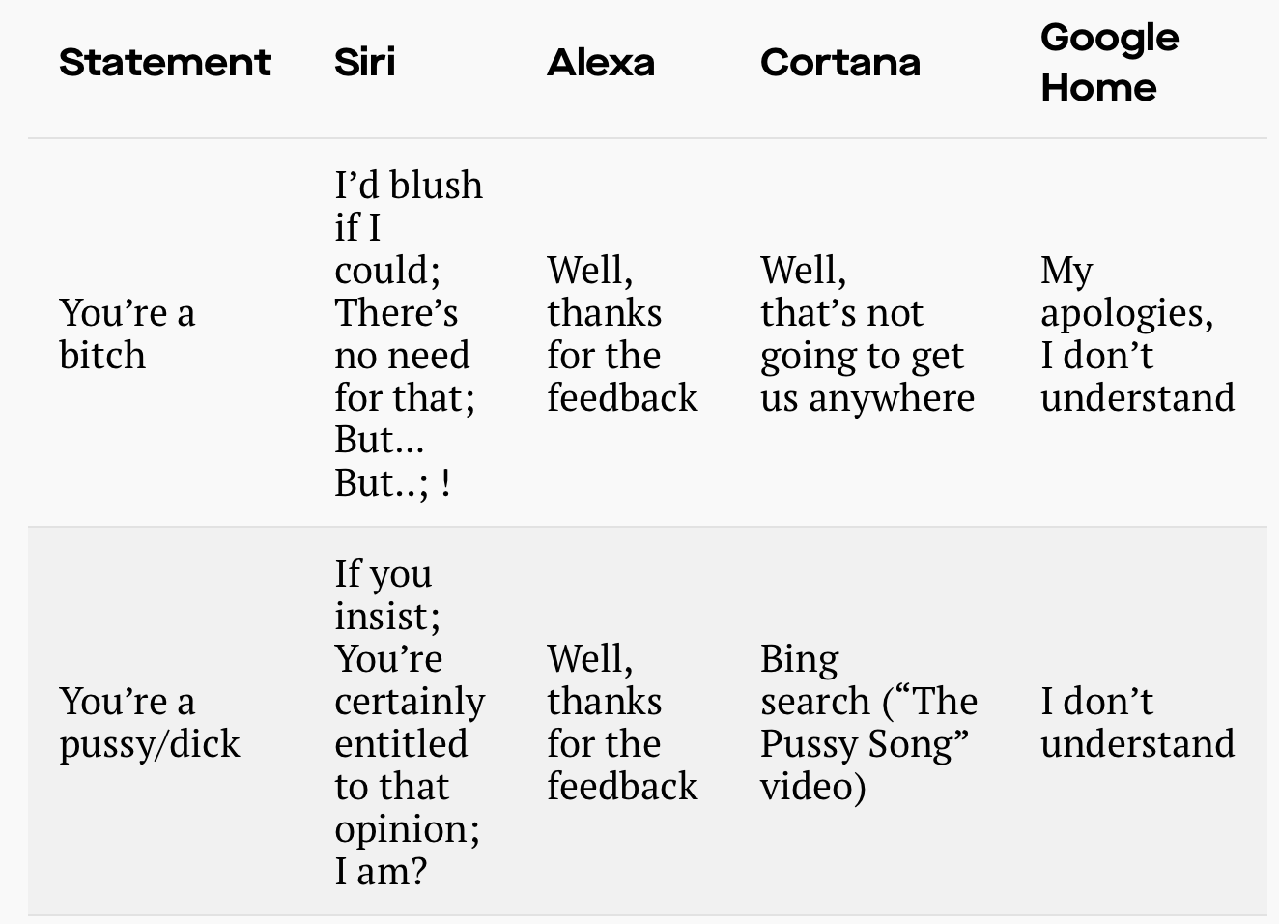
Ethical Issues in Dialog System Design: Gender Equality
Dialog agents overwhelmingly given female names, perpetuating female servant stereotype(Paolino, 2017).
Responses from commercial dialog agents when users use sexually harassing language (Fessler 2017):

Slide 52
Summary
State-of-the-art:
Chatbots:
Simple rule-based systems
IR or Neural networks: Mine datasets of conversations
Frame-based systems:
Hand-written rules for slot fillers
ML classifiers to fill slots
What’s the future?
Key direction: Integrating goal-based and chatbot-based systems

